Slide 1
Developing an Implicit Measure of Intelligence Mindset
Christina Bejjani & Brenda Yang
April 18, 2018 | BRITE Ideas

Slide 2

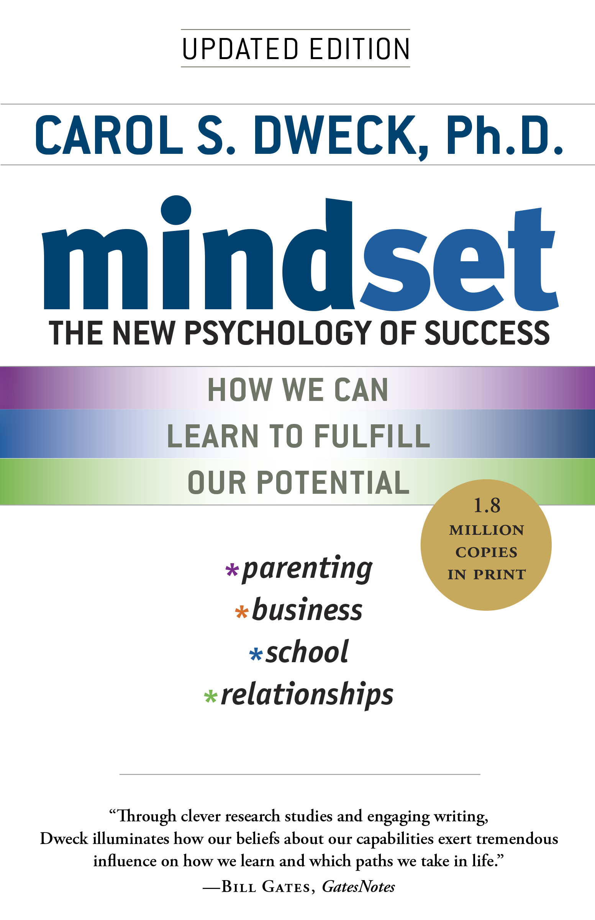

Slide 3

mindsets matter

Slide 4
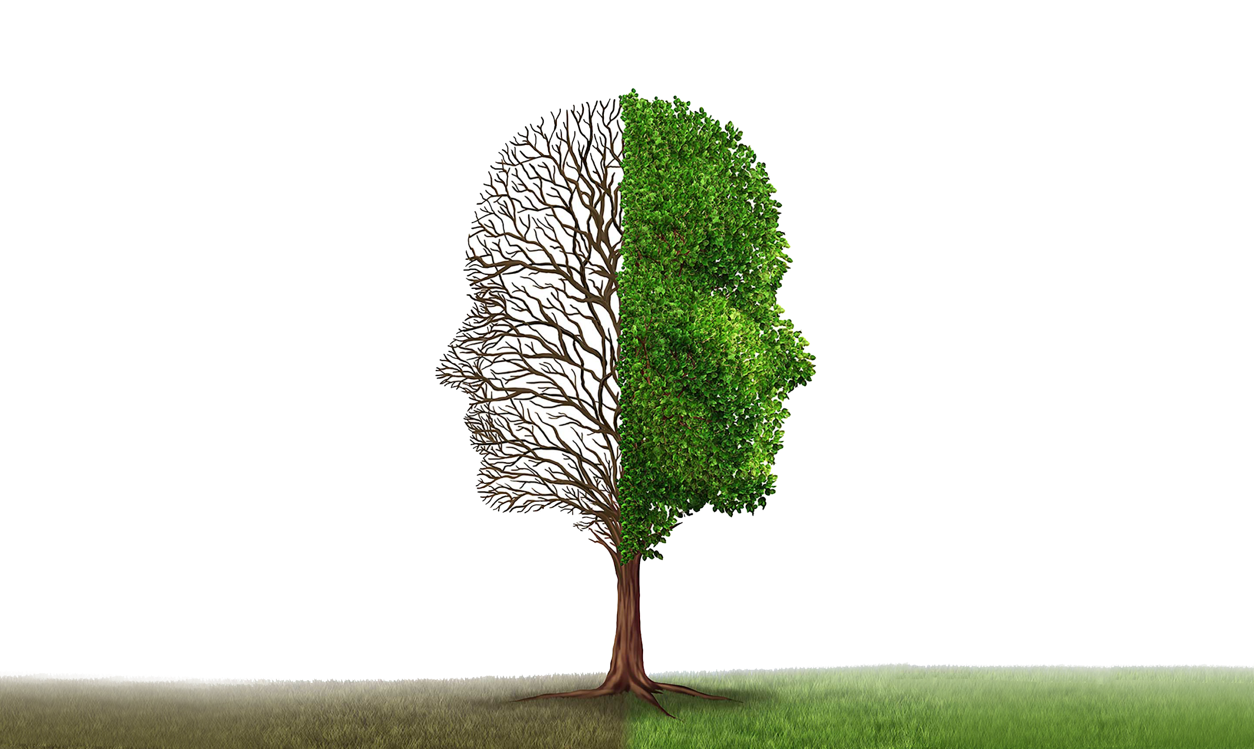
fixed
growth
Avoid challenges
Embrace challenges
Give up easily
Persist in the face of setbacks
See effort as fruitless or worse
See effort as the path to mastery
Ignore useful negative feedback
Learn from criticism
Feel threatened by the success of others
Find lessons & inspiration in the success of others
Intelligence is static.
Intelligence can be developed.

Slide 5




How can we promote growth mindsets in the classroom?
Explicitly teach
Celebrate
Mistakes
Praise the Process, Not the Person
Tasks that Promote Struggle & Growth
mindsetkit.org

Slide 6
But, people can have
false growth mindsets.

Slide 7
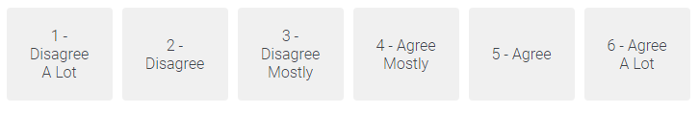
“You can always greatly change how intelligent you are.”

Slide 8

Can intelligence mindsets be measured without the use of an obvious scale?

Slide 9

Study Goals
Test the feasibility of open writing responses and judgment questions to detect intelligence mindset
Identify false growth mindsets with our alternative measures
Validate our measures as better predictors of academic outcomes

Slide 10
Study Goals
Test the feasibility of open writing responses and judgment questions to detect intelligence mindset
Identify false growth mindsets with our alternative measures
Validate our measures as better predictors of academic outcomes

Slide 11
Part I:
Code responses by hand
Part II:
Automated text analysis (e.g. LIWC, machine learning)

Slide 12

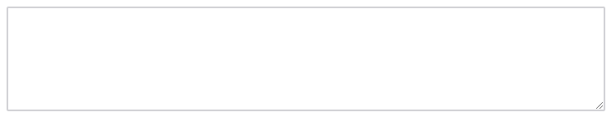

Think of someone intelligent. Explain why you would describe them that way.

Slide 13
“A Pratt Star who rarely studies, frequently STINFs but gets As.”
“They are extremely hard-working and committed to putting in the time and effort that it takes to learn.”

Slide 14
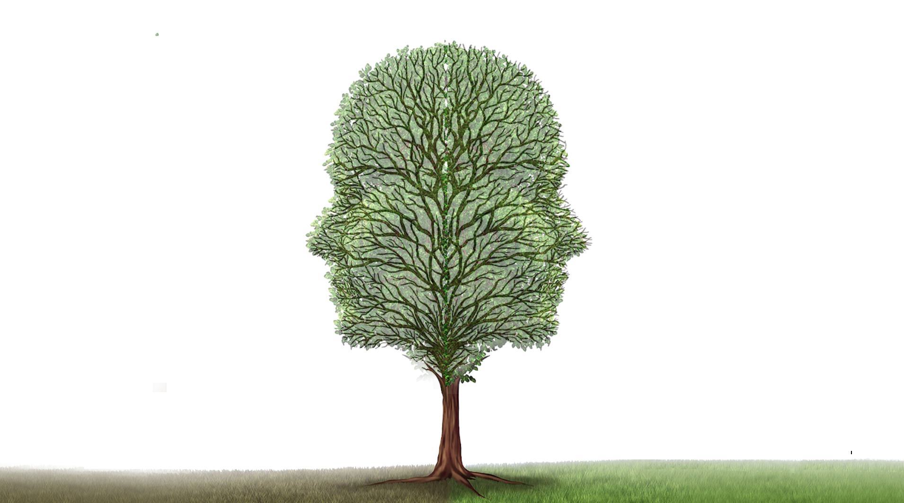

Slide 15
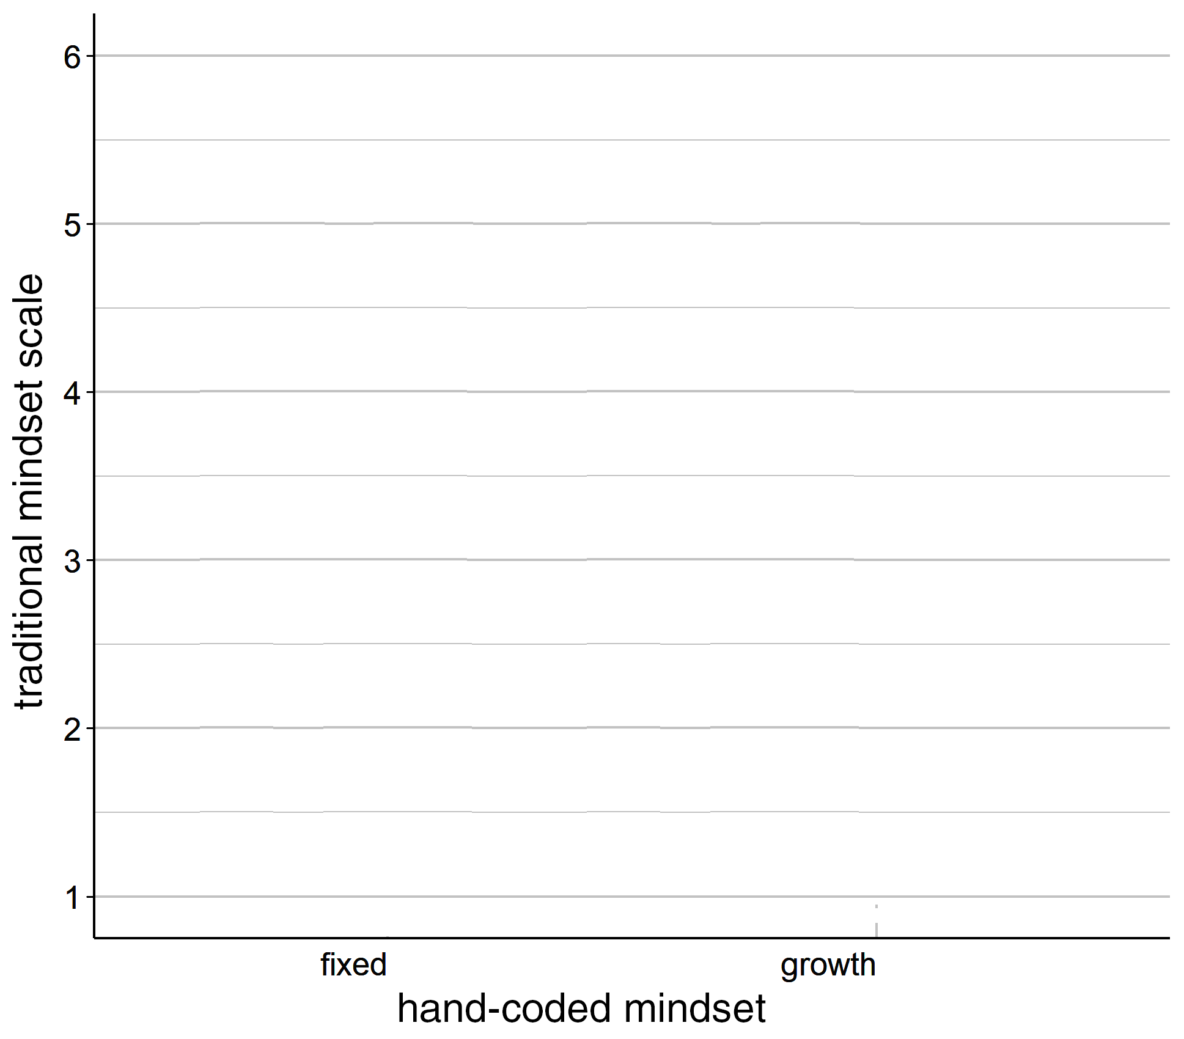
growth
fixed

Slide 16
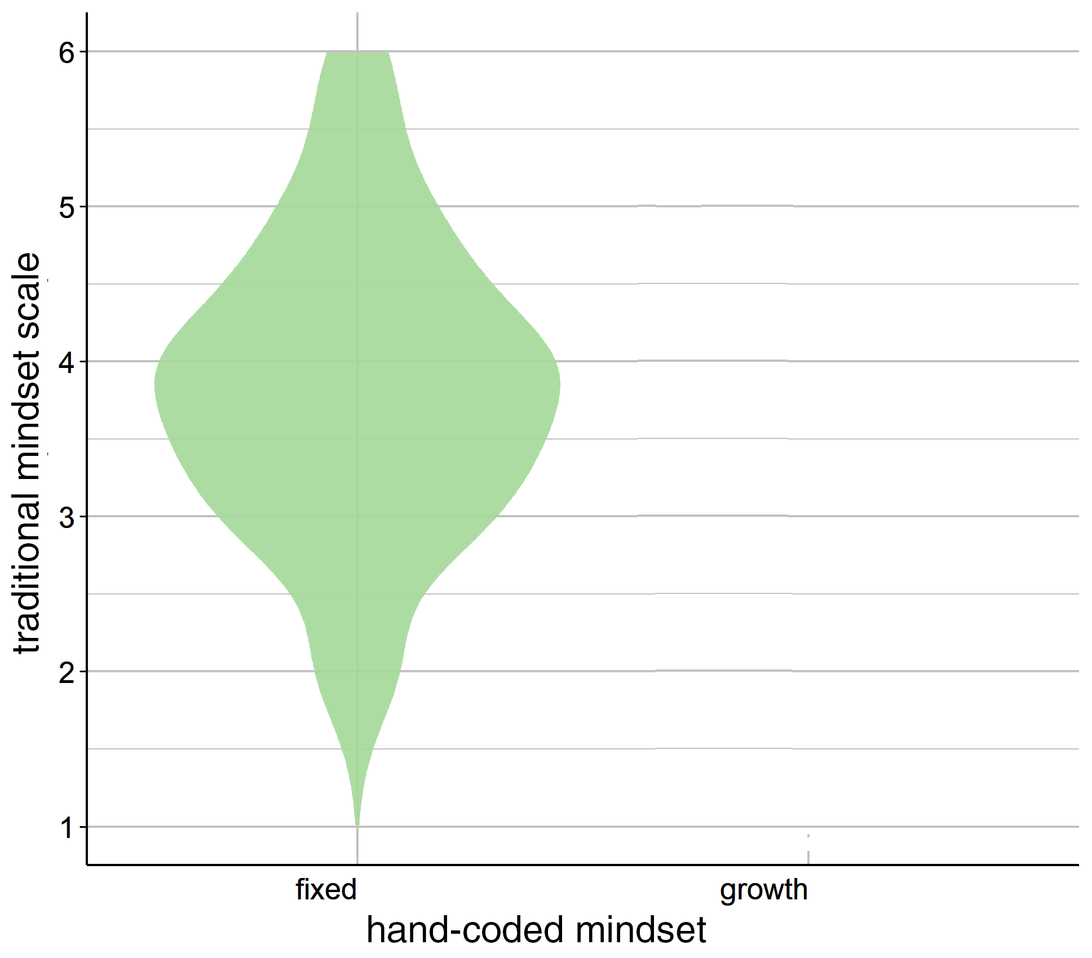
growth
fixed

Slide 17
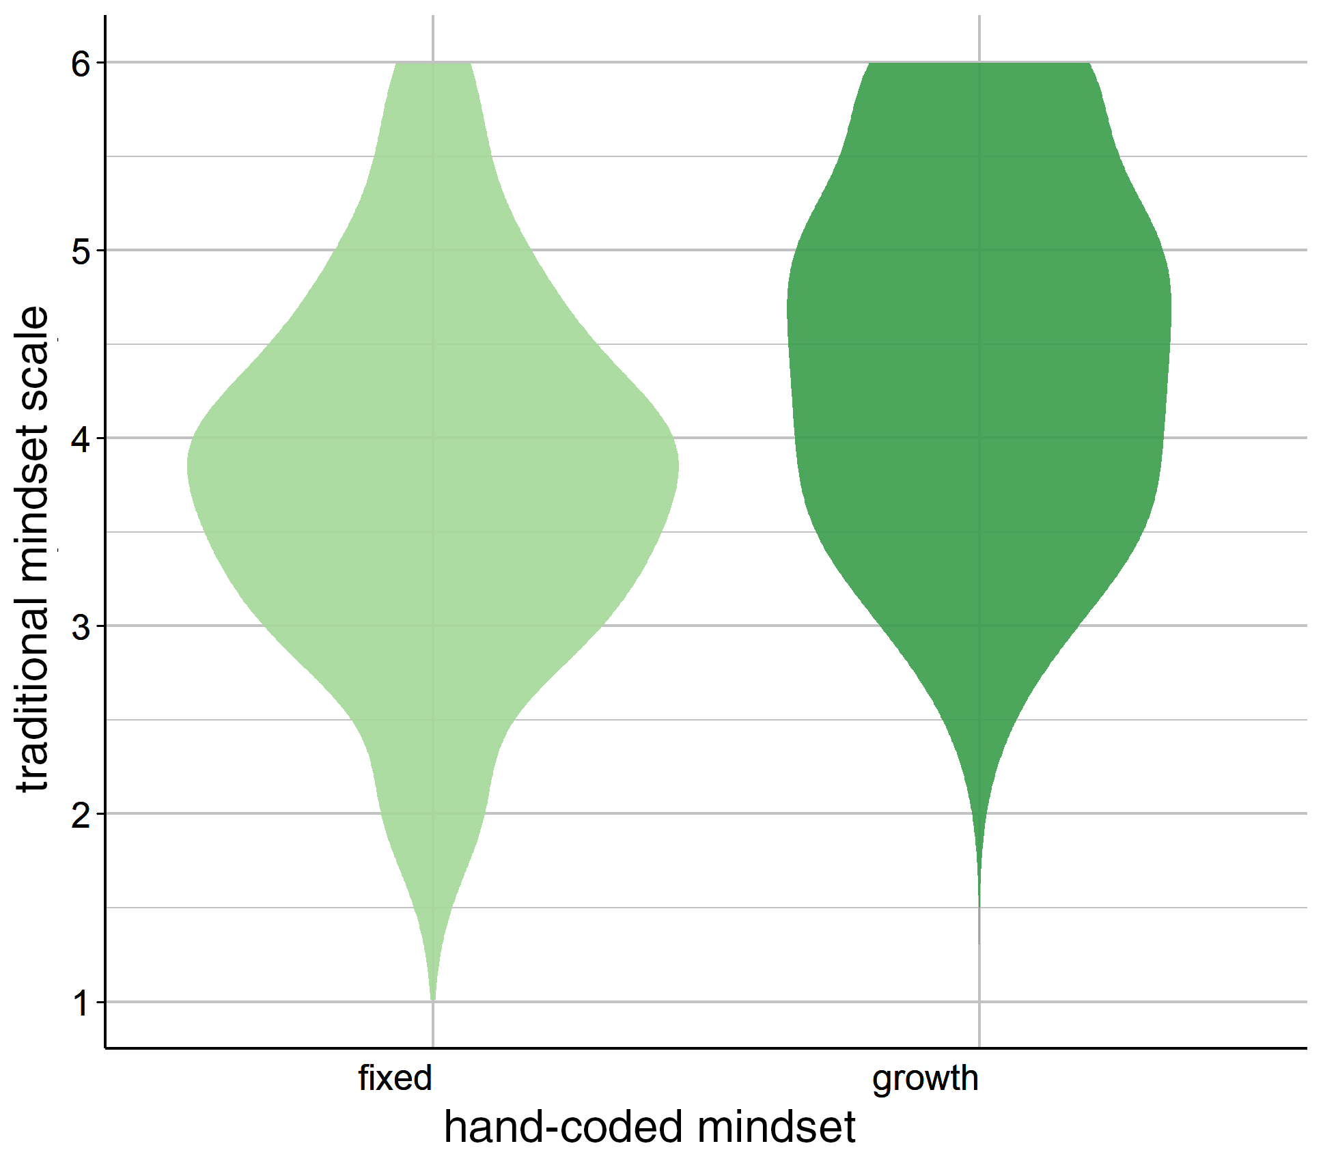
growth
fixed

Slide 18
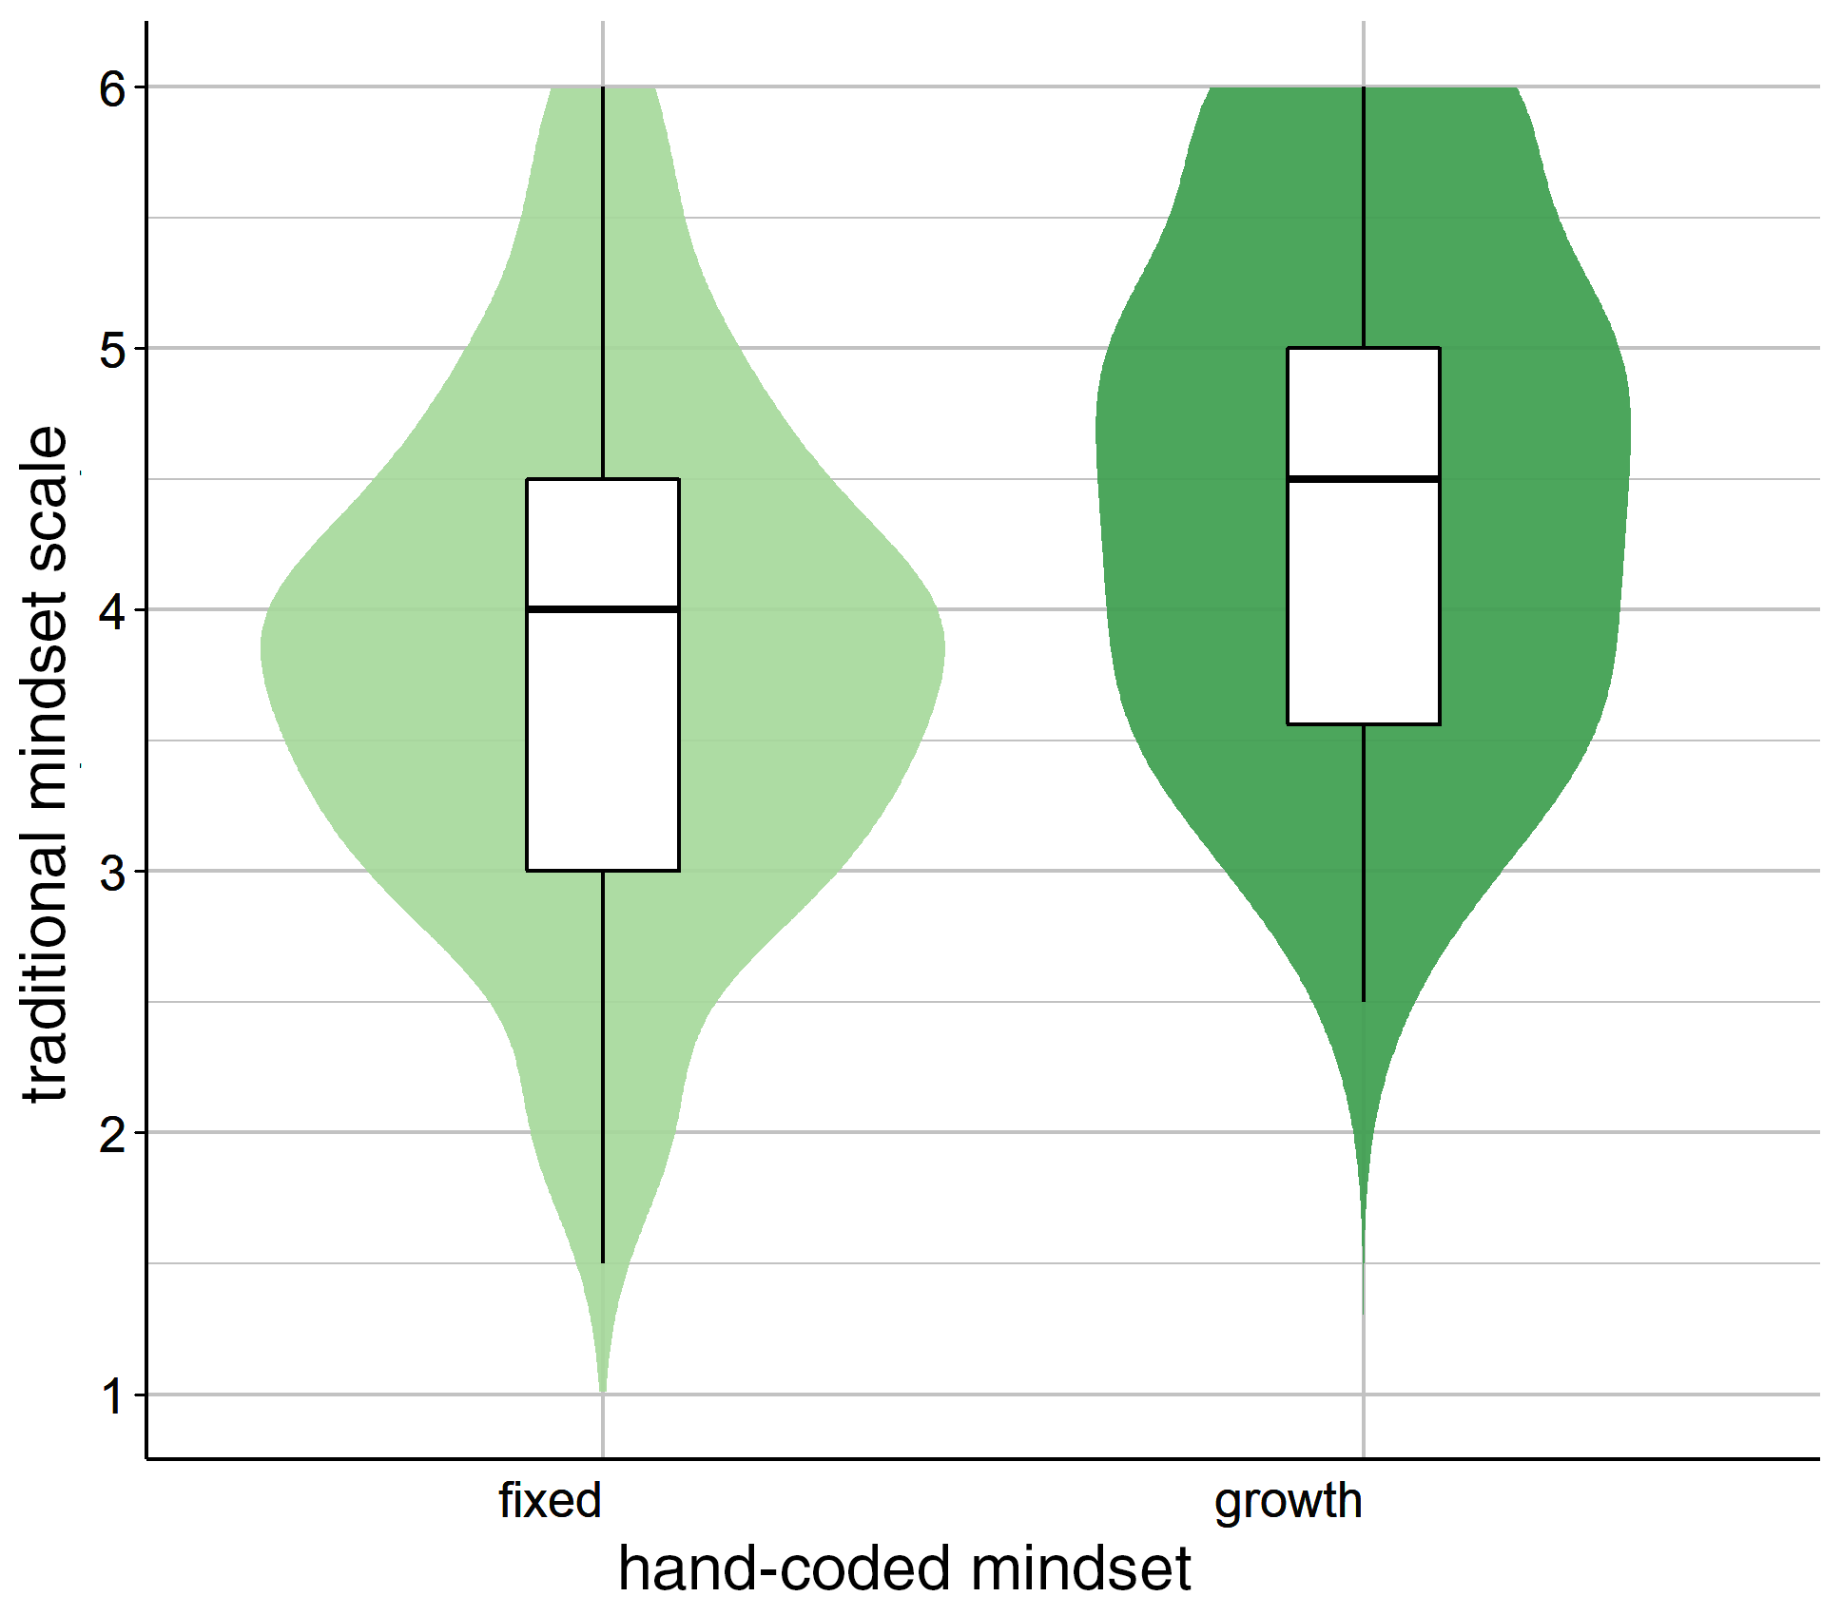
growth
fixed
n = 171, p < .0001, d = [.35, 1.03]

Slide 19
What do you think CAUSED the person you described to be so intelligent?

Slide 20
“My wife fits this description. In part due to her genetics (her family as a whole is artistically gifted)...”
“I think that the person studies a lot which caused him to be so intelligent. The things that he reads and watches makes him who he is.”

Slide 21
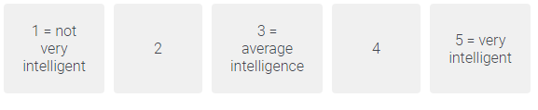

Consider someone who...
always puts in a lot of effort to do well in school.
B
Best guess about their intelligence? Why?

Slide 22
1
“This person isn't very intelligent because for them to have to put a lot of effort to do well in school, it means they lack the innate mental ability and have to work hard to get good grades”
5
“I think that this person is very intelligent because you can always make yourself smarter. If you put in more effort, you'll do better.”

Slide 23
Study Goals
Test the feasibility of open writing responses and judgment questions to detect intelligence mindset
Identify false growth mindsets with our alternative measures
Validate our measures as better predictors of academic outcomes

Slide 24

future directions

Slide 25

take-aways
Mindset shapes life and academic outcomes.
Intelligence mindsets are detectable in open writing responses and judgment questions.

Slide 26
Thanks!
Dr. Hard
Our fellow BRITE presentees
Carol Dweck
Template from Slide Carnival
Stock photos from Unsplash

Slide 27
Bonus slides

Slide 28
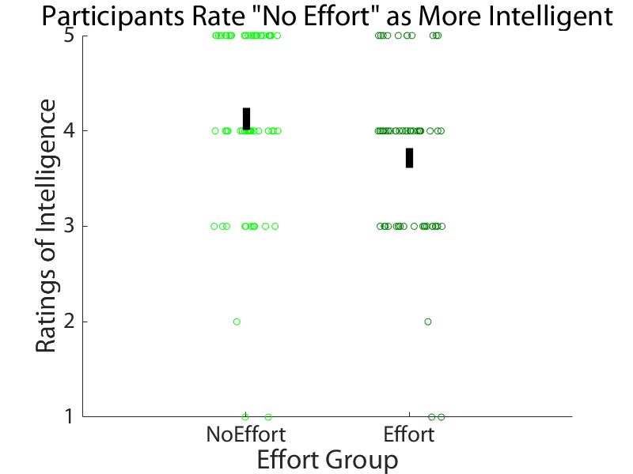

Slide 29
Examples of False Growth Mindsets
“They can take a test and not study more than an hour. They have straight As.” Yet a score of 5.75 (growth) on scale.
“A Pratt Star who rarely studies, frequently STINFs but gets As.” Yet a score of 5 (growth) on scale.
“They understand concepts without having to study as much.” Yet a score of 5 (growth) on scale.

Slide 30
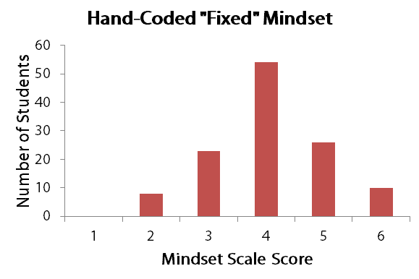
fixed
growth

Slide 31
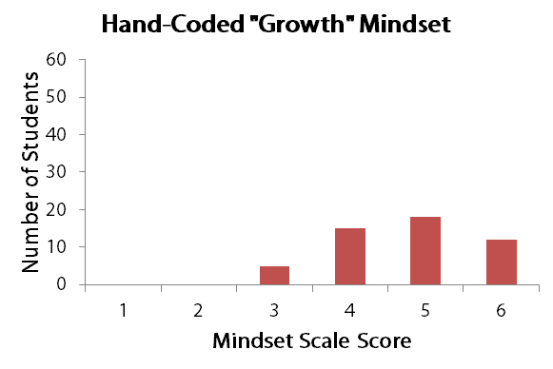
fixed
growth

Slide 32

pilot dataset
multiple semesters
fall 2016, fall 2017, winter 2017, spring 2018
large sample
N = 703 undergraduates
multiple campuses
Stanford and Duke
prompt
“Think of someone you know who you'd describe as ‘intelligent.’ In just a sentence or two, say WHY you would describe that person as intelligent.”
mindset measure
Contains 4 items of traditional theory of intelligence scale
Spring 2018
very related measures
beliefs
effort
mistakes
perseverance (hard)
Other semesters

